Slide 1
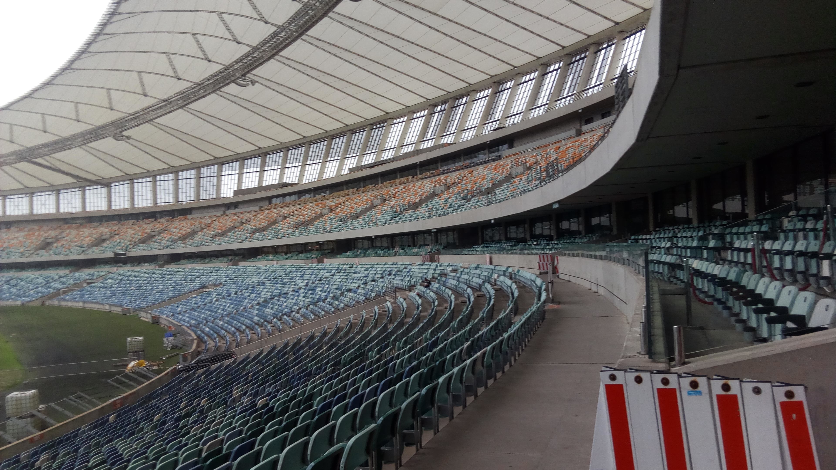
Role of professional claims management in minimizing of construction disputes
PRESENTED BY ENG. BYANGIRE PAUL RUSOKE, R.ENG, PMP, MICCP

Slide 2
Basics
• A claim is an assertion of a party’s right under the terms of a contract or at law.
•The objective of a claim is to demonstrate that the claimant has entitlement to compensation and to demonstrate the amount of compensation.
•The objective of a response document is to set out the findings of the determination of the claim.

Slide 3
Basics
•If a risk event occurs that is the responsibility of the Employer, then the
•Contract provides that the Contractor should be compensated.
•In order to be compensated for a risk event, the Contractor is obliged to submit a claim

Slide 4
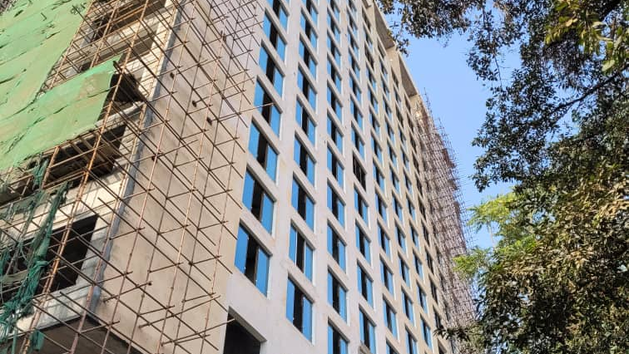
WHAT DO YOU CLAIM
Extra Payment
Extension of Time
Both Time and Payment

Slide 5
ELEMENTS OF A PROFESSIONAL CLAIM
Cause
Effect
Entitlement
Substantiation

Slide 6
Causes (the cause is what happened)
The cause dictates the type of claim or claims arising from the event. It could be;
Late or restricted access to the site
Instruction to carry out additional work
Late drawings, instructions or information
Exceptionally adverse climatic conditions
Instruction to suspend the work
Instruction to accelerate the work

Slide 7
EFFECT(The consequences of the cause)
Is Time, Cost or Both
Establish the direct link between the cause and effect
Which activities were affected?
Did the event introduce new activities into the programme?
When did the delay start?
When did the delay finish?

Slide 8
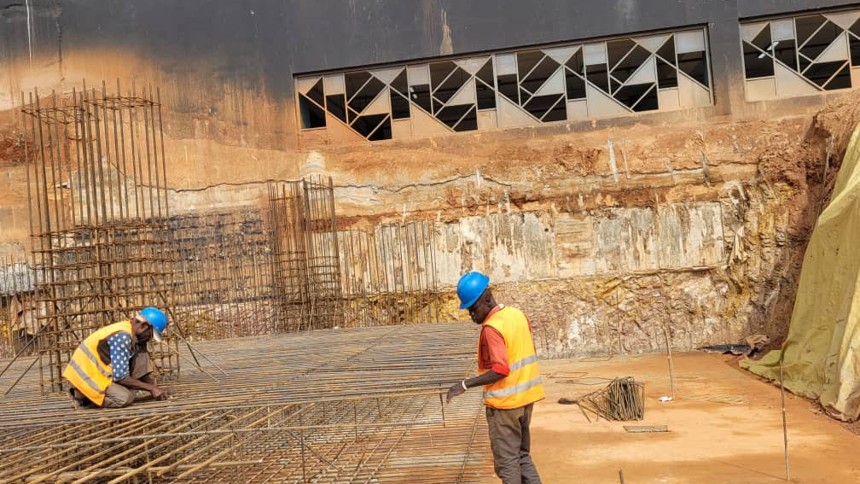
EFFECT(The consequences of the cause)
Is a Delay, Cost implication?
Establish the direct link between the cause and effect
Which activities were affected?
Did the event introduce new activities into the programme?
When did the delay start?
When did the delay finish?

Slide 9
DELAY ANALYSIS& RECORDS
•Whereas a variation can be evaluated by rates for similar work in the contract, Extension of Time is evaluated by a delay analysis (Several of them)
•It is therefore important that Contractors& Consultants take serious the issue of RECORDS.
•The SCL protocol is widely used as a basis for delay analysis.

Slide 10
RECORDS
•Site Diary
•Minutes of site meetings
•Instructions (book)
•Equipment logbooks
•Audited books of Accounts
•Pay slips
•Notices
•Work Program. (Acceptable)

Slide 11
NOTICES
•The notifying document should clearly state that it is a notice
•Reference to the clause(s) that requires the notice and/or provides entitlement
•Describe the event or circumstances
•Reference to the date of the event or circumstances
•State whether you are claiming fot Time, Money or both

Slide 12
NOTICES
Clause 20.1 (Contractor’s Claims) provides:
‘If the Contractor considers himself to be entitled to any extension of the Time for Completion and/or any additional payment, under any Clause of these Conditions or otherwise in connection with the Contract, the Contractor shall give notice to the Engineer, describing the event or circumstance giving rise to the claim’. …… ‘NOT LATER THAN 28 DAYS after the Contractor became aware (or should have become aware) of the event or circumstance. If the Contractor fails to give notice of a claim within such period of 28 days, the Time for Completion shall not be extended, the Contractor shall not entitled to additional payment,…..’

Slide 13
•Show in the contract the clause(s) that entitle you to the award
•Where an event gives rise to several claims, it is best to handle the Cause-Effect –Entitlement for each claim separately.
Sometimes, you may not get the entitlement in the contract but it is provided in law.
ENTITLEMENT

Slide 14
SUBSTATIATION
•The evidence of the cause and effect.
•Better to be submitted in a chronological order.
•Tables and formulae should be explained.
•Programmes should be presented in a readable format.

Slide 15
COSTS
•Variation costs (For lumpsum contracts)
•Standing costs for idle time
•Site management
•Site establishment
•Non-productive plant& Equipment
•Contractual costs
•Finance costs
•Head office overheads& Profits

Slide 16
DETERMINATION
•The " Engineer" under FIDIC has to produce a determination of the Contractor's claim
Best Done using the format above commenting on each section with reasons

Slide 17
THE ICCP
16-18 Finch Road, Douglas
Isle of Man
IM1 2PT
For a Recognised Professional Claims Qualification
See Brochure for more details

