Slide 1


The Critical Role Played by ADR in the management of disputes in the Land, Water and Built Environment
David Kaggwa, FCIArb

Slide 2

What is ADR.
Alternative Dispute Resolution (ADR) is the term used to describe ways of resolving a dispute without going to court.
Types of ADR
Negotiation.
Adjudication
Mediation
Arbitration
Expert Determination.

Slide 3
Adjudication
The most common form of ADR to resolve construction disputes is Adjudication.
It was established in the UK by the Housing Grants, Construction and Regeneration Act 1996 (commonly referred to as the Construction Act).
This Act states that any party to a construction contract can refer any dispute to an impartial adjudicator for a decision.
In Uganda Adjudication is contractual.
Adjudication aims to resolve the dispute quickly, fairly and cost-effectively, usually within 28 days.
Adjudication decision is binding though not final.
Pay Now Argue Later.
80% of Construction disputes are resolved through Adjudication.
The World Bank has adopted the use of DAABs.

Slide 4
Arbitration
Arbitration is a form of alternative dispute resolution in which both disputing parties agree to a decision by an independent arbitrator (or a panel of arbitrators).
The process is formal, similar to court proceedings, but unlike open court, it is private and confidential.
The arbitrator will usually be an expert in the subject of the dispute.
The parties present their cases to the arbitrator, who assesses the evidence and decides which party’s case is most persuasive.
The arbitrator’s Award is final and legally binding. This means that if a party doesn’t like the arbitrator’s findings, they cannot try to get a better outcome by taking the case to court.
Arbitration can be quicker and more cost-effective than going to court.

Slide 5
Expert Determination
Expert determination is a private process in which an independent technical expert is appointed by the parties or by an appointing authority like CADER, ICAMEK, or the Court).
The Role of the expert is to conduct their own investigation and reach a decision on the dispute.
Expert determination is often used when the dispute focuses on a technical issue rather than a legal one, such as boundaries, quantities, or values.
The technical expert will be required to use their expertise, knowledge, and experience to reach a decision.
The decision can be binding or non-binding.
The expert also doesn’t have to consult with the parties before making their decision, which can save time and money.
Expert determination is often used alongside other dispute resolution processes, mostly mediation and arbitration.

Slide 6
ADR & Commerce
Uganda’s GDP is estimated to reach US $ 60 Billion in 2025.
The African Continental Free Trade Area (AfCFTA) is a free-trade area outlined in the African Continental Free Trade Agreement.
The largest in the world since the formation of the World Trade Organisation.
With a combined GDP of an estimated US$3.4 trillion, the pact connects 1.3 billion people living in different parts of the continent.
Disputes are likely from Infrastructure, Oil & Gas, Energy, Trade, and Land transactions.

Slide 7
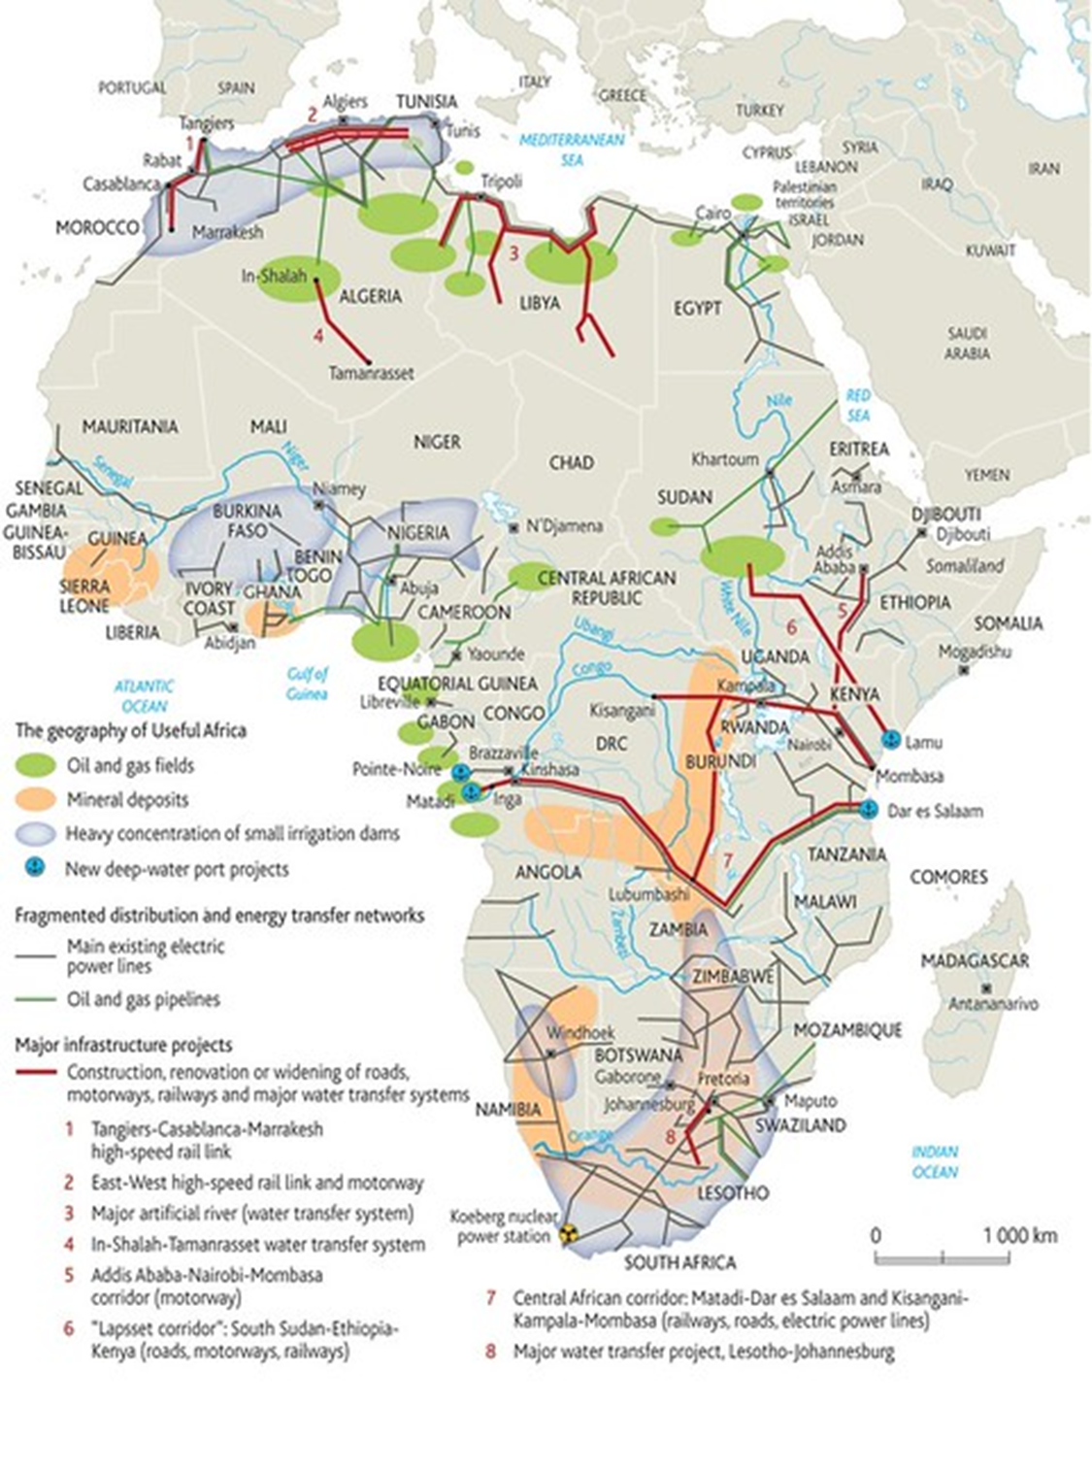
Africa Infrastructure
Cross boarder ADR Practice.

Slide 8
Possible Water Disputes
Migingo Island (conflict over fishing rights in Lake Victoria).
The River Senegal (conflict between Mauritania and Senegal).
The River Zambezi (conflict between Zambia, Zimbabwe and Botswana).
The River Nile (conflict between Egypt and Ethiopia).

Slide 9
Land Surveyors in ADR
Jennifer Nsubuga v Michael Mukundane & Shine Asiimwe CACA No.208 of 2018;
A survey report co-authored by an unregistered surveyor and a supposed supervisor who did not take part in the survey was invalid.
Section 19(3) of the Surveyors Registration Act (3), “no person shall engage in or carry out the practice of surveying by whatever name called unless he or she is the holder of a valid practising certificate granted to him or her in that behalf under this Act.”

Slide 10
Valuation Surveyors in ADR
Attorney General & NEMA v DMW (U) Limited, CACA No. 314/20
A qualification in geology does not qualify one to undertake the valuation of assets. That would be the prerogative of a qualified valuer or valuation surveyor. Such a professional valuer might procure the services of a geologist when conducting an earth valuation, but that would not render the geologist akin to a valuer.
The fact that the compensatory orders made by the trial court were primarily premised on the now-impugned valuation reports should dispel any questions about the vitality of the additional evidence to the pending Appeal. It is absolutely relevant to the determination of the Appeal.
Further, having been provided by the head of a professional regulatory body that regulates the valuation sector, it is adjudged to be plausible and, to that extent, credible for the purposes of this Application.

Slide 11
Quantity Surveyors in ADR
Andreas Wipfler T/A Wipfler Designers & Co. v Meera Investments Ltd, HCCS No. 28 of 2005.
The Court entered judgment in a sum contained in an expert’s report when he held thus;
The parties agreed to be bound by the expert’s report. In essence, they appointed an arbitrator between them.
Applying the inherent jurisdiction of this court, I uphold the agreement the parties made before this court to be bound by the report of the expert that they jointly appointed.
As the expert has found in his report that the sum of shs.172,770,293.00 is due to the plaintiff from the defendant, I enter judgment for the plaintiff in that sum with the costs of the suit.

Slide 12
Dispute Avoidance
FIDIC 2017 introduced DAABs (Dispute Avoidance and Adjudication Boards). FIDIC Contracts have been adopted by MDBs such as:
World Bank
European Investment Bank (EIB)
Islamic Development Bank (IsDB)
Asian Development Bank (ADB)
European Bank for Reconstruction and Development (EBRD)
CAF - Development Bank of Latin America (CAF)
Inter-American Development Bank Group (IDB, IADB)
African Development Bank (AfDB)

Slide 13
Dispute Avoidance
FIDIC 2017 introduced DAABs (Dispute Avoidance and Adjudication Boards). FIDIC Contracts have been adopted by MDBs such as:
World Bank
European Investment Bank (EIB)
Islamic Development Bank (IsDB)
Asian Development Bank (ADB)
European Bank for Reconstruction and Development (EBRD)
CAF - Development Bank of Latin America (CAF)
Inter-American Development Bank Group (IDB, IADB)
African Development Bank (AfDB)

Slide 14
Dispute Resolution Board Foundation
Pledge.
We believe in collaborative working and early intervention techniques throughout the supply chain, to resolve differences of opinion before they escalate into disputes.
We recognise the importance of embedding conflict avoidance mechanisms into projects to identify, control and manage potential conflict whilst preventing the need for adversarial dispute resolution procedures.
We commit to working proactively to avoid conflict and to promote early resolution of potential disputes.
ADOPT Tiered ADR Clauses in your Contracts; Negotiation, Mediation, Adjudication and Arbitration.

Slide 15
Chartered Institute of Arbitrators - Uganda Chapter
Plot 28A Golf Course Road,
0200 954 512 | +256 772 474 695
info@ciarbuganda.org
www.ciarb.org

